Slide 1
The euro crisis
Lars Calmfors
Fores
14 January 2014

Slide 2
Ten-year government bond yields, per cent

Slide 3
Four interrelated crises
Sovereign debt crisis
Bank crisis
Growth crisis
Competitiveness crisis

Slide 4
Interrelations between the crises
Sovereign debt crisis and banking crisis
- banking crisis triggered sovereign debt crisis (Ireland)
- sovereign debt crisis aggravated bank crisis (Cyprus)
Growth crisis and banking crisis
- banking crisis exacerbated the recession
- the recession aggravated the banking crisis
Growth crisis and sovereign debt crisis
- low growth has aggravated (triggered) debt crisis (Spain)
- fiscal austerity to solve the debt crisis has caused low growth
Competitiveness crisis and growth crisis
- need for real depreciations
- they require large employment losses

Slide 5
Government debt dynamics: mathematics

Slide 6
Government debt dynamics: verbal mathematics
Change in the government debt ratio = (Primary
fiscal deficit as a ratio to GDP) + (Nominal interest
rate – Nominal GDP growth rate) x (Initial government debt
ratio)
Government debt ratio = (Government debt)/GDP
Primary fiscal deficit = Government expenditure less
government revenues excluding interest payments

Slide 7
General government gross consolidated debt, per cent of GDP

Slide 8
Strategy to deal with the soverign debt crises
Rescue loans plus conditions on fiscal austerity
The objective is to turn the primary deficits into primary surpluses
It is theoretically possible that fiscal tightening causes such a large fall in GDP, and thus in tax revenues, that the primary balance deteriorates
This cannot be ruled out, although most estimates of fiscal multipliers imply that they are not sufficiently large for this to occur

Slide 9
Change in general government primary fiscal balance 2009-2013, per cent of GDP

Slide 10
Short-run and long-run effects of fiscal tightening
It is the strengthening (change) in the fiscal balance that is contractive, not remaining in a stronger position
Once the effects of the change have occurred, capacity utilisation will gradually increase again
But this requires price and wage adjustments
Real depreciations must occur in the crisis countries
Once the adjustment is completed, higher capacity utilisation will mean higher tax revenues
Provided that the fiscal policy is sustained and is pushed far enough (so that primary deficits turn into primar surpluses) it will contribute to a falling government debt ratio

Slide 11
Changes in unemployment and labour costs relative to the euro area: Greece

Slide 12
Changes in unemployment and labour costs relative to the euro area: Spain

Slide 13
Primary fiscal balance, per cent of GDP (cyclically adjusted balance in parenthesis)
2012 2013 2014
Cyprus | -3.3 (-3.2) | -4.2 (-1.6) | -4.3 (-1.5)
Ireland | -4.5 (-3.8) | -2.8 (-2.3) | -0.2 (-0.2)
Greece | -4.0 (1.8) | -9.4 (-3.4) | 2.8 (7.3)
Italy | 2.5 (4.3) | 2.3 (4.8) | 2.8 (4.8)
Portugal | -2.1 (-0.4) | -1.6 (0.6) | 0.3 (1.9)
Spain | -7.6 (-5.2) | -3.3 (-0.9) | -2.4 (-0.7)
France | -2.3 (-1.1) | -1.8 (-0.2) | -1.4 (0.2)

Slide 14
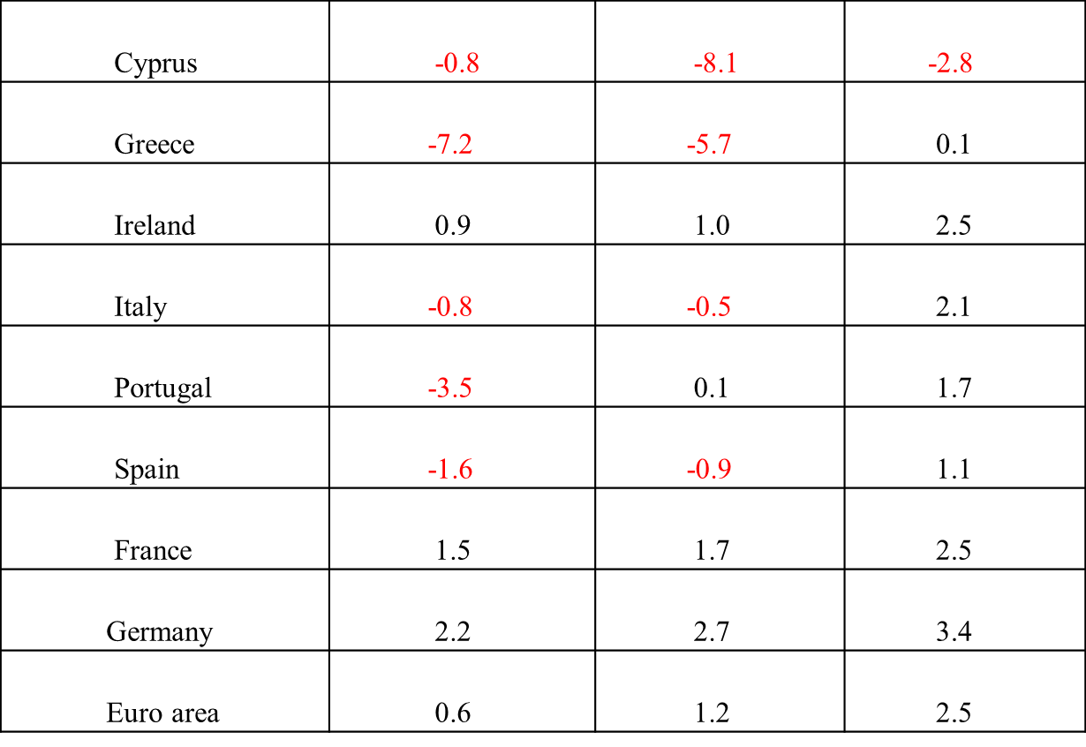
Change in nominal GDP, per cent
2012 2013 2014

Slide 15
Conclusions on the austerity strategy
Eventually government debt ratios will begin to fall
But it will take a long time until they return to more prudent levels
- first the rises that have occurred during the fiscal adjustment period must be worked off
Undesirable hardship for citizens during a very long period
Huge political risks
- support for the EU
- trust in politicians at large
- rises of populist (extremist) parties

Slide 16
Trust in the European Union and national governments and support for the euro
 | Trust in the EU |  | Trust in the national government |  | Support for the euro
 | Spring 2007 | Autumn 2013 | Spring 2007 | Autumn 2013 | Spring 2007 | Autumn 2013
EU28 | 60 | 38 | 44 | 28 | 65 | 57
Eurozone | 61 | 36 | 45 | 29 | 72 | 66
Austria | 46 | 39 | 57 | 50 | 67 | 65
Finland | 61 | 47 | 75 | 50 | 81 | 75
France | 51 | 28 | 36 | 14 | 72 | 63
Germany | 56 | 29 | 49 | 38 | 72 | 71
Netherlands | 69 | 38 | 73 | 37 | 77 | 71
Cyprus | 61 | 17 | 64 | 26 | 50 | 44
Grece | 63 | 21 | 41 | 10 | 47 | 62
Ireland | 54 | 34 | 41 | 17 | 88 | 70
Italy | 58 | 23 | 37 | 10 | 67 | 53
Portugal | 65 | 25 | 46 | 15 | 64 | 50
Spain | 65 | 21 | 52 | 9 | 68 | 56

Slide 17
Measures to facilitate adjustment
More expansionary fiscal policy in the core (Germany)
Higher wage cost increases in Germany
- internal revaluation (higher employer
contributions and lower income taxes)
ECB should do more to keep inflation in the euro area at the target of two per cent
The ECB could raise its inflation target to three och four per cent

Slide 18
Likely developments
Unlikely that the fiscal austerity required for substantial government debt reductions in the crisis countries will be sustained
Financial markets may buy the crisis countries’ government bonds for some time anticipating thay they can sell to the ECB
But at some time there will again be a sudden stop
The ECB then has to carry out actual purchases and/or the ESM to grant new loans

Slide 19
Need for debt forgiveness
Substantial haircuts on outstanding debt
- capital losses for the ESM and the ECB
- capital losses for banks and bank failures
- there would have to be resources for recapitalisation of banks
- agreement on banking union does not provide for this
Let the ECB buy government bonds from the crisis countries
- exchange them for perpetual interest-free loans
- in the short run no inflation risk, so this could be financed by
printing money
- in the longer term money supply increases must be sterilised
- the ECB could issue interest-bearing debt or impose reserve
requirements on banks
- either way costs to citizens in core countries

Slide 20
Summing-up
The euro crisis is not over
The problem of unsustainable government debt in the crisis countries is not solved
The fiscal austerity strategy carries large risks and is likely to be unsustainable
Debt forgiveness is unavoidable
Substantial haircuts now would be desirable but will not happen as the mechanisms for avoiding a banking crisis in such a situation do not exist
Debt forgiveness will come in the future and in covert ways

