Slide 1
The case for Swedish tax reform
Lars Calmfors
Revisiting tax reform – a European Perspective
European Commission – Stockholm
23 April 2015

Slide 2
Outline of my speech
Recent proposals on tax reform
1990/91 tax reform
The development of the tax system over the last 25 years
Have changes been motivated or not?
My preferred tax reform
Political obstacles to reform
How might a tax reform come about?
Incremental reforms versus comprehensive reform

Slide 3
Recent proposals on tax reform
ESO report by Peter Birch Sörensen 2010
Fiscal Policy Council 2011
Skattereform för 2000-talet (ed. Mats Bergstrand) 2014
Saco report 2014
Debate article in Dagens Nyheter by chief economists at LO and Saco 2014
Recommendations on changes in the tax system from IMF, OECD and the European Commission

Slide 4
Overall objective: Provide public goods and meet income distribution aims with as small efficiency costs as possible
Simplicity and neutrality
Optimal taxation
Simple tax system
Treat economically equi-valent activities in a uniform way
Pessimistic view of the availability of information
Complex tax systems likely to be exploited by interest groups
Fine-tuning of the tax system
Minimise distortions
Taxing gainful activities that are most affected by taxes the least and vice versa
Optimistic view on the availability of information
Belief that politicians can withstand lobbying

Slide 5
1990/91 tax reform
Dual income tax system
- 30 per cent capital income tax rate
- progressive taxation of labour income
Broadening of the corporate income tax base and lowering of tax rate to 30 per cent
Broadening of the labour income tax base and capping of the top marginal tax rate at 50 per cent
Uniform VAT rate of 25 per cent
Real estate tax, gift and inheritance taxes, wealth tax formed part of the system

Slide 6
Subsequent changes
Top marginal tax rate on labour income increased to 57 per cent (värnskatten)
- total marginal tax rate including employer contributions: 70 per cent
Earned income tax credit
Lower employer contributions for youth
Differentiated VAT rates
Tax reductions for household services (RUT)
Tax reductions for RMI (ROT)
State real estate tax replaced by low municipal fee
A multitude of different tax rates for capital income
Abolition of gift, inheritance and wealth taxes
More liberal rules regarding income for closely held companies (3:12 rules)
Lower corporate income tax rates

Slide 7
Changes in the economic environment
Globalisation
- motivates lower corporate income taxation
- argument (but rather weak) for reductions of
the top marginal tax rate on labour income
- motivates more reliance on real estate taxes
Higher unemployment
- motivates earned income tax credit
- motivates tax reduction for household services

Slide 8
Changes in the economic environment cont. (1)
New knowledge about behavioural effects of taxes
- motivates earned income tax credit: employment more
responsive to the return to work than hours per person
- taxable income more responsive to the return to work
than hours
Trend towards more income inequality driven by unevenly distributed capital incomes
- at odds with replacement of real estate tax by low
municipal fee
- at odds with abolition of gift, inheritance and wealth
taxes

Slide 9
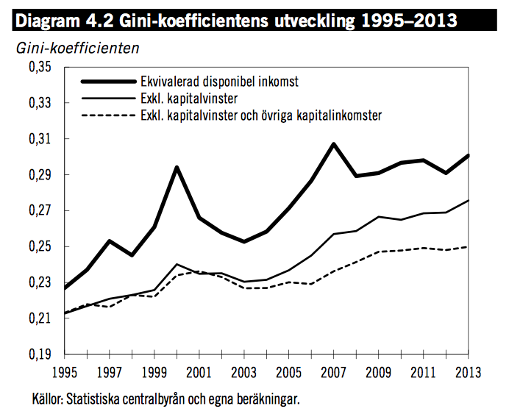

Slide 10
Changes in the economic environment cont. (2)
Lower inflation has reduced capital income taxation of real returns
Real rate of return of 4 per cent, inflation of 3 per cent and nominal rate of return of 7 per cent
- 30 per cent nominal taxation gives 2,1/4 = 50
per cent taxation of the real rate of return
Real rate of return of 4 per cent, inflation of 0 per cent and nominal rate of return of 4 per cent
- 30 per cent nominal taxation gives 1,2/4 = 30
per cent taxation of the real rate of return

Slide 11
Developments of the economic environment and changes in the tax system
Changes in conformity with developments
Changes in conflict with developments
Lower corporate income taxation
Earned income tax credits
Tax reduction for household services
Abolition of real estate tax
Higher marginal taxes on labour income
Lower capital income taxation
Abolition of gift, inheritance and wealth taxes

Slide 12
Other arguments
Also arguments in favour of lower capital income taxation
- high efficiency costs
- savings are sensitive to the return
- incentives to supply labour are also affected
Differentiation of VAT rates hard to defend
- Rates have been reduced where they should be high
- Food (low sensitivity of demand to price)
- Cultural events, ski lifts, hotels, restaurants
(complements to leisure)

Slide 13
An appropriate tax reform for Sweden
Reduce top marginal tax rate on labour income (25 per cent) and also the state labour income tax of 20 per cent for lower income brackets
Alternatively employer contributions to the social insurance system could be reduced for incomes above benefit ceilings
- or benefit ceilings could be raised
Introduce a uniform VAT rate.
Reinstate a real estate tax or rather a tax on the imputed value of owning
your own home.
- make the real estate tax progressive!
- dampening rules
- ceililng on fraction of income
- abolish capital gains tax on homes and stamp duties

Slide 14
An appropriate tax reform cont.
Make capital income taxation uniform
Apply capital gains taxation on stock to unrealised instead of realised gains
- automatic stabiliser of the business cycle
Reintroduce gift and inheritance taxes
Make the tax rules for closely held companies stricter (3:12 rules).

Slide 15
The big problem
Economists do not make up the majority of voters
Tax considerations are difficult to explain
The best taxes are those that fall on ”necessary” activities and therefore have small behavioural consequences
- lump-sum taxes
- real estate
- food
But those are exactly the taxes people dislike

Slide 16
Earlier experience
The earlier Swedish experience suggests that tax reform needs to be comprehensive
Then various changes can be balanced against each other
- efficiency gains at the same time as distri-
bution issues can be handled
Some policy makers have suggested that a precondition for tax reform is that it is so complicated that the voters do not understand it

Slide 17
Obstacles to tax reform
Important benefits but the problems are not as large and as obvious as in the 1970s and 1980s
- no general debate in society
No international trend towards tax reform
No desire on the part of politicians to agree on taxes
- rather a preferred area of conflict
The Swedish Democrats complicate the picture
Politics less based on convictions and more on the short-run impact on opinion polls than in the past

Slide 18
Factors working in favour of tax reform
Demographic pressures on public finances
- Baumol’s disease
- Wagner’s law
Large efficiency costs if municipal tax increases raise marginal tax rates on labour income
Need for increased defence spending
- agreed spending increases are ridiculously low
- 0.5-1 per cent of GDP in increases is more
realistic
Earmarking of specific taxes (real estate tax)?

Slide 20
Factors working in favour of tax reform cont.
Also the 1990/91 took a long time in coming
Proposals on tax reform over a long period
Such proposals are now forthcoming
This could be a first step towards reform

Slide 21
Can incremental changes work?
Reduced interest deductability instead of real estate tax?
- only second-best solution
- asymmetries introduced
Some changes will be in the right direction, more in the wrong direction
Politicians will not take responsibility for the overall system
- short-run expediency will dominate over long-run
considerations
So economists have to continue arguing for comprehensive tax reform

